Slide 1
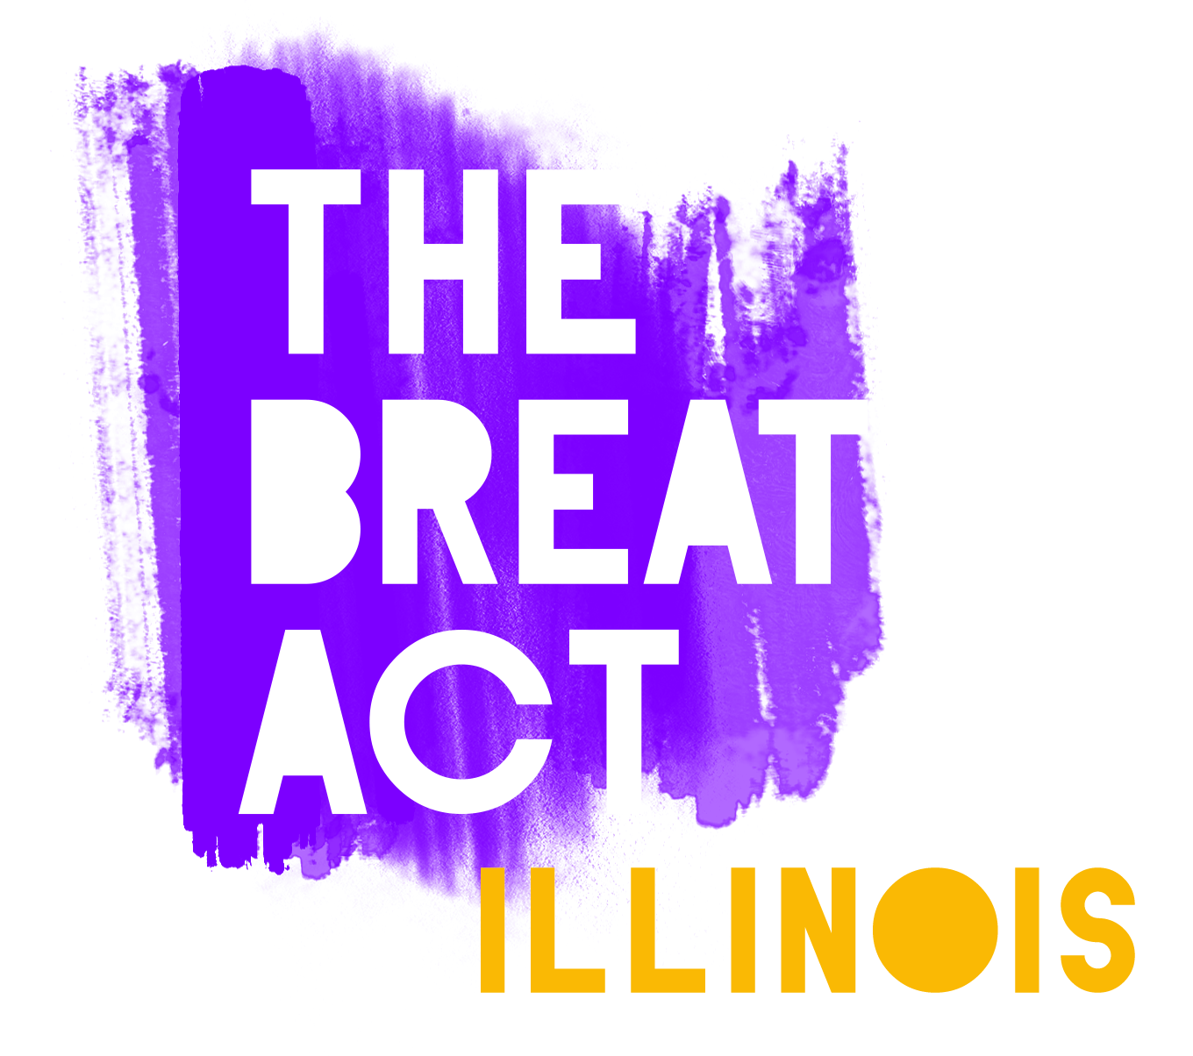
The BREATHE Act is a project of the Movement for Black Lives’ 501(c)4 Electoral Justice Project. Contact us at policy@m4bl.org.

Slide 2
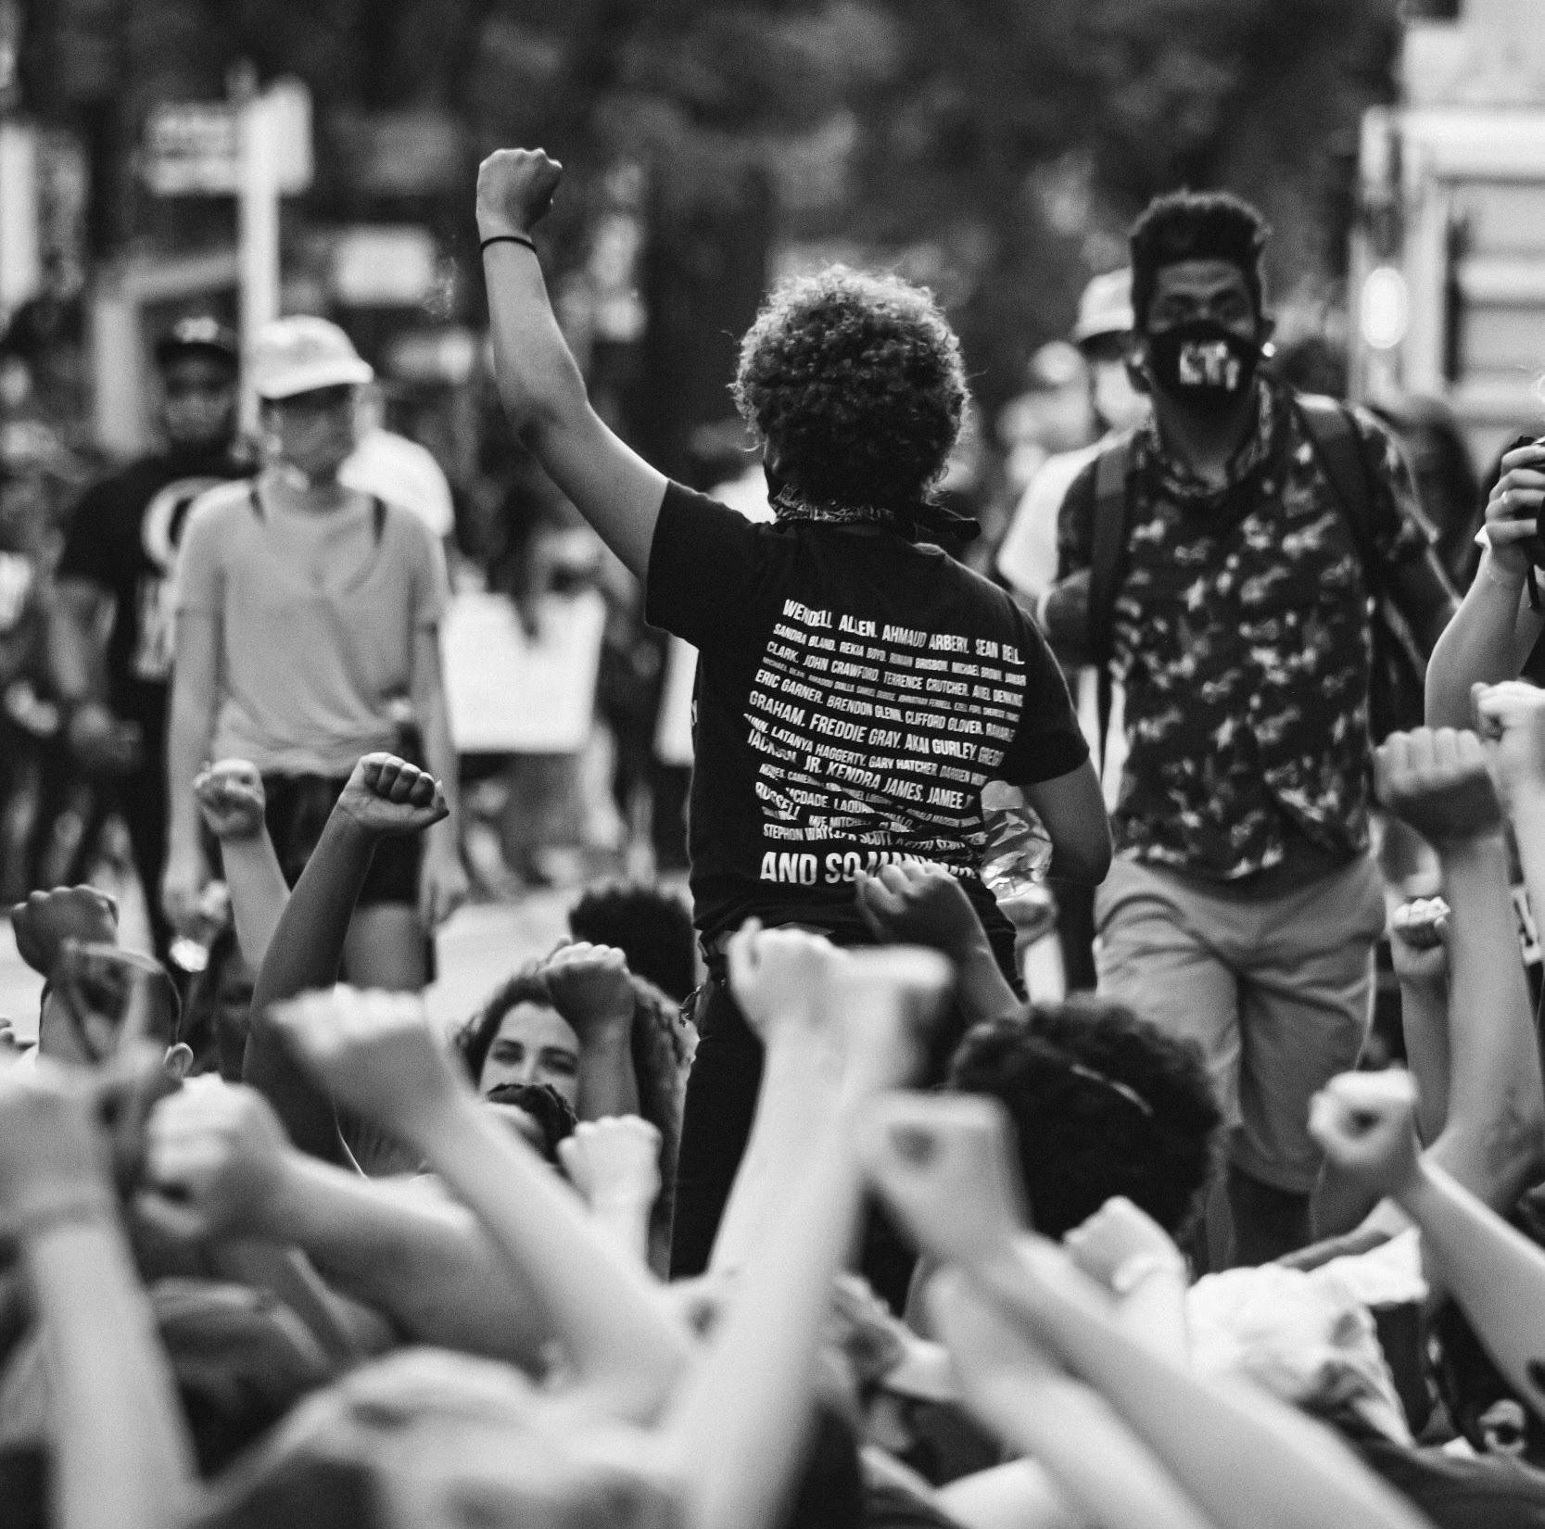
Section-by-Section Bill Summary
SECTION 1:
Creating Systems of Accountability and Transparency Around Policing
SECTION 2:
Demilitarization and Reducing Police Power & Interaction
SECTION 3:
Ending the Carceral State, and Repairing Criminal-Legal System Harms
SECTION 4:
Redistributing Resources to Build Healthy, Sustainable & Equitable Communities for All People
The BREATHE Act is a project of the Movement for Black Lives’ 501(c)4 Electoral Justice Project. Contact us at policy@m4bl.org.
Photo credit: Nana Andoh

Slide 3
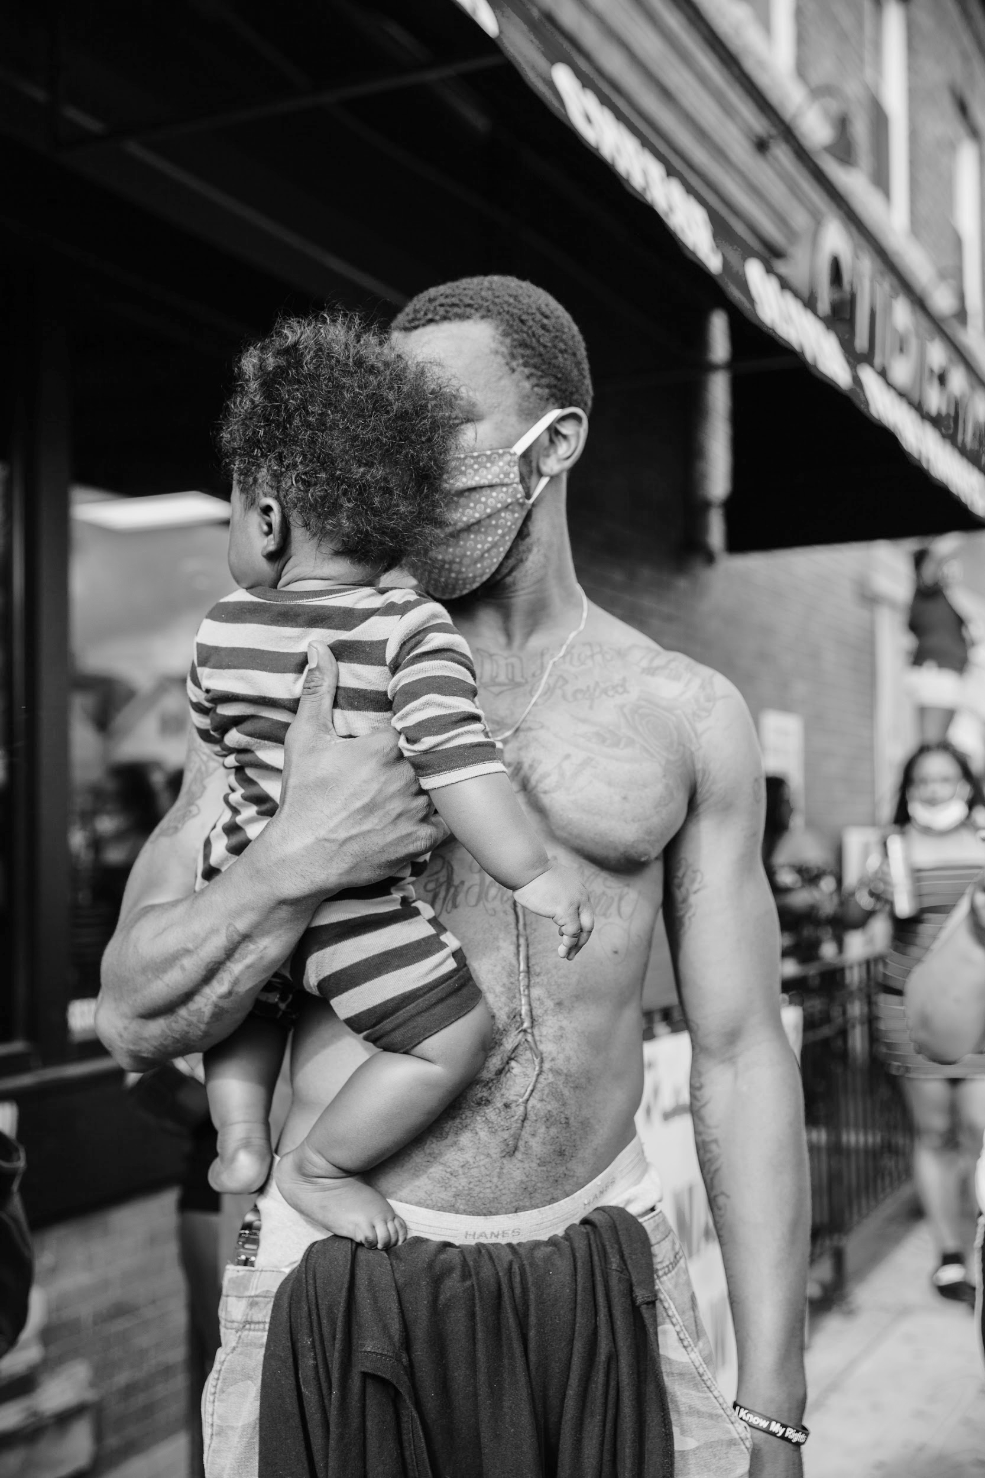
SECTION 1:
Creating Systems of Accountability and Transparency Around Police Misconduct
THE BILL WOULD:
Establish guidelines for investigations and reports of every officer-involved shooting and officer-involved death to promote transparency and accountability by requiring that
At least two investigators be assigned per investigation, one of whom is the lead investigator and neither of whom is employed by a law enforcement agency that employs the officer(s) who are the subject of the investigation
No investigation shall exceed 90 days
Upon the conclusion of an investigation or prosecution, whichever occurs last, any and all investigatory materials shall be considered a “public record” as defined under 5 ILCS 140/2(c)
A special prosecutor be appointed from the Office of the Illinois Attorney General whenever the defendant is an agent of a law enforcement agency within the jurisdiction of that
state’s attorney
The BREATHE Act is a project of the Movement for Black Lives’ 501(c)4 Electoral Justice Project. Contact us at policy@m4bl.org.

Slide 4
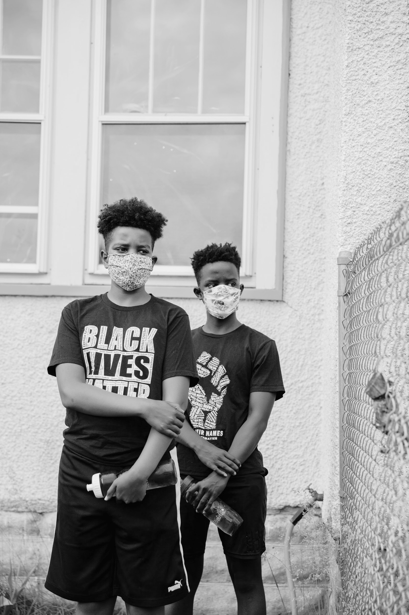
Reduce barriers to civil action in response to racial profiling and deprivation of rights by
Eliminating qualified immunity as a defense to racial profiling and deprivation of rights
Eliminating statutory immunities and statutory limitations on liability, damages, or attorney fees to claims brought against racial profiling and deprivation of rights
The BREATHE Act is a project of the Movement for Black Lives’ 501(c)4 Electoral Justice Project. Contact us at policy@m4bl.org.
Notes:
REMOVED: Establishing a Neighborhood Demilitarization Program, which will facilitate the collection and safe destruction of all military equipment that is possessed by local, State, and federal law enforcement;

Slide 5
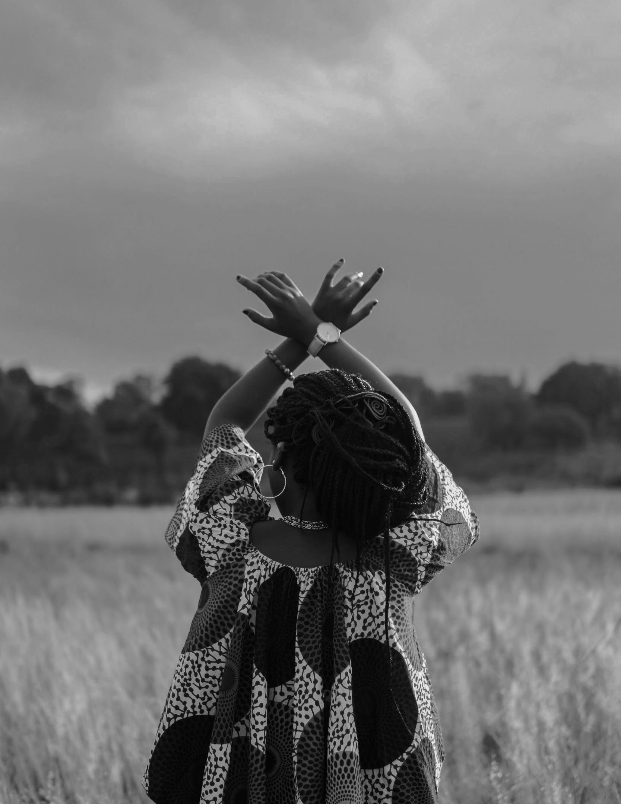
SECTION 2:
Demilitarization and Reducing Police Power & Interaction
THE BILL WOULD:
Demilitarize the police and reduce funding by requiring that
No law enforcement agency may apply for or obtain any property from the Department of Defense
No law enforcement agency may use any property obtained from the Department of Defense
Federal Resources be divested from incarceration and policing
Surveillance tactics that are disproportionately used to target Black, Brown, and Muslim communities are prohibited including predictive policing, facial recognition technologies, drones, and similar tools be banned
Any officer in violation of these terms be terminated and referred to the Illinois Law Enforcement Training Standards Board for decertification
Prohibit excessive use of force by
Modifying Section 7-5, Section 7-6, Section 7-8, Section 7-9 of the Illinois Compiled Statutes (720 ILCS 5) to limit use of force
Modifying Section 7 of the Illinois Compiled Statutes (870 ILCS 5) to prohibit use of flash-bangs grenades and stun grenades, grenade launchers, tear gas, and other chemical agents
The BREATHE Act is a project of the Movement for Black Lives’ 501(c)4 Electoral Justice Project. Contact us at policy@m4bl.org.

Slide 6
Maintain systems of accountability by
Mandating stricter policies around certifying and decertifying police officers
Repealing Police Officer Bill of Rights, provided that police officers maintain their right to counsel
Reduce police interaction by
Funding The S.A.F.E.R. Communities Fund to create Behavioral Intervention and Civilian Review Boards
Developing a Behavioral Health Unit that utilizes a range of strategies and approaches to provide non-police and non-criminal justice system responses to behavioral health and crisis incidents
Requiring all call-takers, dispatchers, and their supervisors to receive trauma-informed crisis intervention training that is adequate to enable them to identify, dispatch, and appropriately respond to calls for service that involve individuals in crisis
Prohibiting the use of Illinois State prisons and jails, District Attorney’s, and the Illinois Department of Children and Welfare Services moneys, personnel, or information management systems to investigate, interrogate, detain, detect, or arrest persons for immigration enforcement purposes
Establishing a State Community Public Safety Agency within the Illinois Department of Human Services to conduct research on non-carceral, non-punitive mechanisms to promote public safety and make grants for non-carceral, non-punitive interventions, pilot programs, and demonstration programs
The BREATHE Act is a project of the Movement for Black Lives’ 501(c)4 Electoral Justice Project. Contact us at policy@m4bl.org.

Slide 7
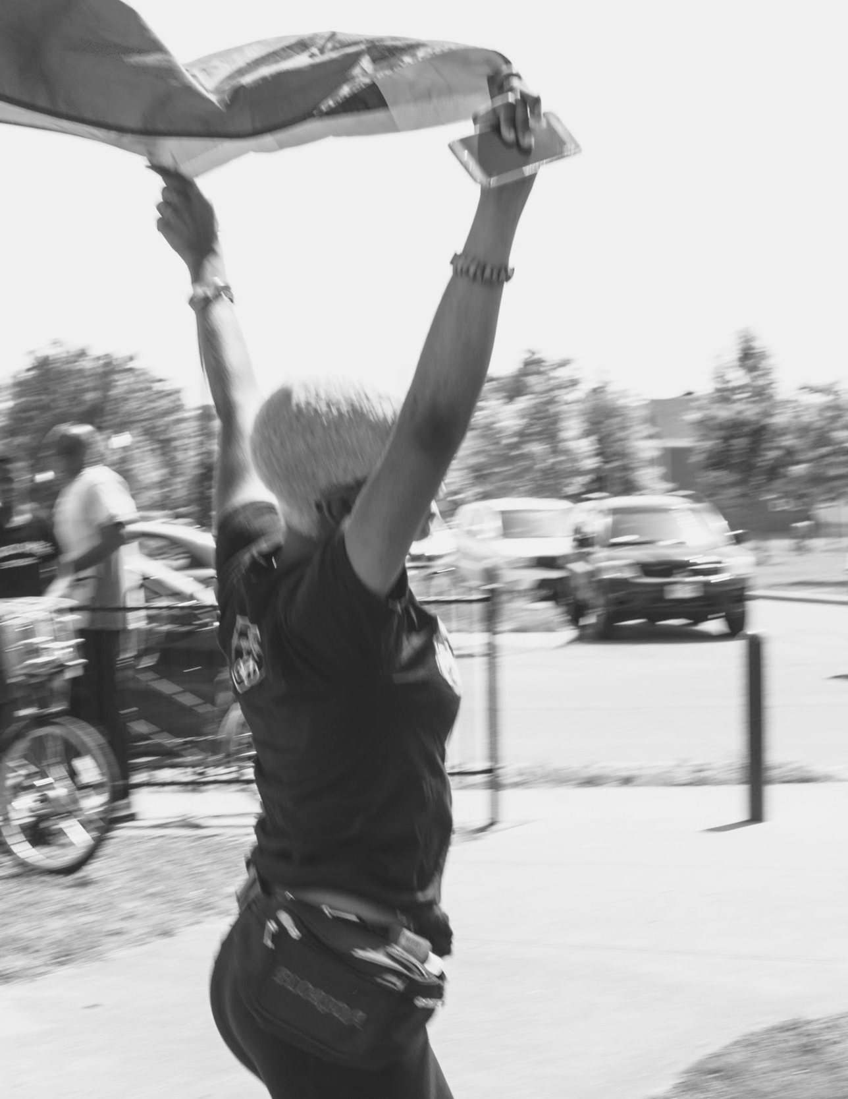
SECTION 3:
Ending the Carceral State, and Repairing Criminal-Legal System Harms
THE BILL WOULD:
Directly make changes to the federal criminal-legal system, including changes to the policing, prosecution, sentencing, and jailing practices that have disproportionately criminalized Black and Brown communities, LGBTQIA people, Indigenous people, and disabled people. Specific changes include, but are not limited to
Eliminating the use of electronic monitoring, including ankle monitors, smartphone applications, and any other tool used to track location
Ending civil asset forfeiture
Abolishing mandatory minimum sentencing laws
Ending life sentences
Mandating an immediate moratorium shall be enacted on new prison, jail, and youth correctional and detention center construction
Developing a time-bound plan to close all federal prisons and immigration detention centers
Mandating immediate resentencing and early sentence termination of sentences for any person who was convicted solely of a drug offense
Creating a Decriminalization Commission to review the State criminal code and publish a report outlining recommendations
The BREATHE Act is a project of the Movement for Black Lives’ 501(c)4 Electoral Justice Project. Contact us at policy@m4bl.org.

Slide 8
Decriminalizing and retroactively expunging drug offenses.
Making any offense that is a Class C misdemeanor, Class B misdemeanor, or punishable by a fine non-arrestable
Repealing the Statewide Gang Database Act
Implement changes to repair and harm done to formerly and currently incarcerated individuals by
Banning solitary confinement
Applying the State minimum wage to incarcerated workers
Prohibiting bans on in-person, contact visits
Prohibiting body cavity searches, visual cavity searches, and strip searches
Eliminating use of restraints, including restraints which interfere with d/Deaf and hard of hearing people’s ability to communicate in ASL
Implementing guidelines for increased automatic expungement
Requiring all State and local occupational licensing boards and agencies to adopt fair chance licensing protections
Allowing all incarcerated individuals to vote
Reducing burden of legal financial obligations through debt forgiveness, fee cuts, and caps on monetary penalties
Increase access to legal representation by establishing the Illinois Legal Services Fund
The BREATHE Act is a project of the Movement for Black Lives’ 501(c)4 Electoral Justice Project. Contact us at policy@m4bl.org.

Slide 9
SECTION 4:
Redistributing Resources to Build Healthy, Sustainable & Equitable Communities for All People
THE BILL WOULD:
Redistribute resources to repair harm from police violence and the War on Drugs by
Establishing an independent Illinois Police Reparations Commission that will operate a Police Violence Reparations Fund and begin the process of making reparation by February 1, 2022
Establishing an independent Illinois War on Drugs Reparations Commission that will operate a War on Drugs Reparations Fund and begin the process of making reparation by February 1, 2022
Incentivize decarceration and subsidize non-punitive, community-led approaches to public safety by
Creating The Community Public Safety Agency to provide grants to community-based organizations that provide non-carceral, non-punitive projects and programs to improve community safety and/or meet the specific needs of particular criminalized groups with a focus on improving safety in local communities through non-carceral accountability, violence reduction, public health, housing, healing, reentry, non-carceral crisis intervention, and more.
Creating grant programs to foster community-led initiatives pursuing environmental & climate justice, housing justice, economic justice, education justice, and health & family Justice
Creating grant programs to incentivize closure of detention facilities, including local jails, youth prisons, juvenile detention facilities, or other detention facilities
The BREATHE Act is a project of the Movement for Black Lives’ 501(c)4 Electoral Justice Project. Contact us at policy@m4bl.org.
Photo credit: Jay Dorsainvil

Slide 10
Join us in defending Black lives.
Join us on the right side of history.
BREATHEACT.ORG
The BREATHE Act is a project of the Movement for Black Lives’ 501(c)4 Electoral Justice Project. Contact us at policy@m4bl.org.
Photo credit: Lawrence Agyei

